Slide 1
Learning Hand-Eye Coordination for Robotic Grasping with Deep Learning
and Large-Scale Data Collection
Sergey Levine SLEVINE @ GOOGLE . COM
Peter Pastor PETERPASTOR @ GOOGLE . COM
Alex Krizhevsky AKRIZHEVSKY @ GOOGLE . COM
Deirdre Quillen DEQUILLEN @ GOOGLE . COM
Google

Slide 2
Introduction
Target
Method
Data collection
Result
Discussion

Slide 3
Introduction
We describe a learning-based approach to handeyecoordination for robotic grasping frommonocular images.
To learn hand-eye coordinationfor grasping, we trained a large convolutional neural network to predict the probability that task-space motion of the gripper will result in successful grasps, using only monocular camera images and independently of camera calibrationor the current robot pose. This requiresthe network to observe the spatial relationship between the gripper and objects in the scene,thus learning hand-eye coordination. We thenuse this network to servo the gripper in real timeto achieve successful grasps.

Slide 4
Introduction
To train our network,we collected over 800,000 grasp attempts over the course of two months, using between 6 and 14 robotic manipulators at any given time,with differences in camera placement and hardware.
Our experimental evaluation demonstrates that our method achieves effective real-time control,can successfully grasp novel objects, and corrects mistakes by continuous servoing.

Slide 5
Target
we propose a learning-based approach to hand-eye coordination, which we demonstrate on a robotic grasping task. Our approach is data-driven and goal-
centric: our method learns to servo a robotic gripper to poses that arelikely to produce successfulgrasps, with end-to-end training directly from image pixels to task-space gripper motion. By continuously recomputing the most promising motor commands, our method continuously integrates sensory cues from the environment, allowing it to react to perturbations and adjust the grasp to maximize the probability of success.

Slide 6
Method
Our method consists of two components: a grasp success predictor, which uses a deep convolutional neural network (CNN) to determine how likely a given motion is to pro-
duce a successful grasp,
a continuous servoing mechanism that uses the CNN to continuously update the robot’s motor commands. By continuously choosing the best predicted path to a successful grasp, the servoing mechanism provides the robot with fast feedback to perturbations and objectmotion, as well as robustness to inaccurate actuation

Slide 7
Visual servoing, also known as vision-based robot control and abbreviated VS, is a technique which uses feedback information extracted from a vision sensor (visual feedback) to control the motion of a robot.
There are two fundamental configurations of the robot end-effector (hand) and the camera:
Eye-in-hand, or end-point closed-loop control, where the camera is attached to the moving hand and observing the relative position of the target.
Eye-to-hand, or end-point open-loop control, where the camera is fixed in the world and observing the target and the motion of the hand.

Slide 8
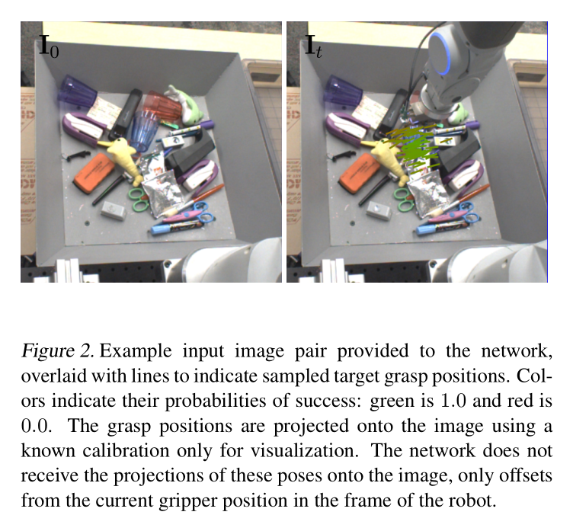
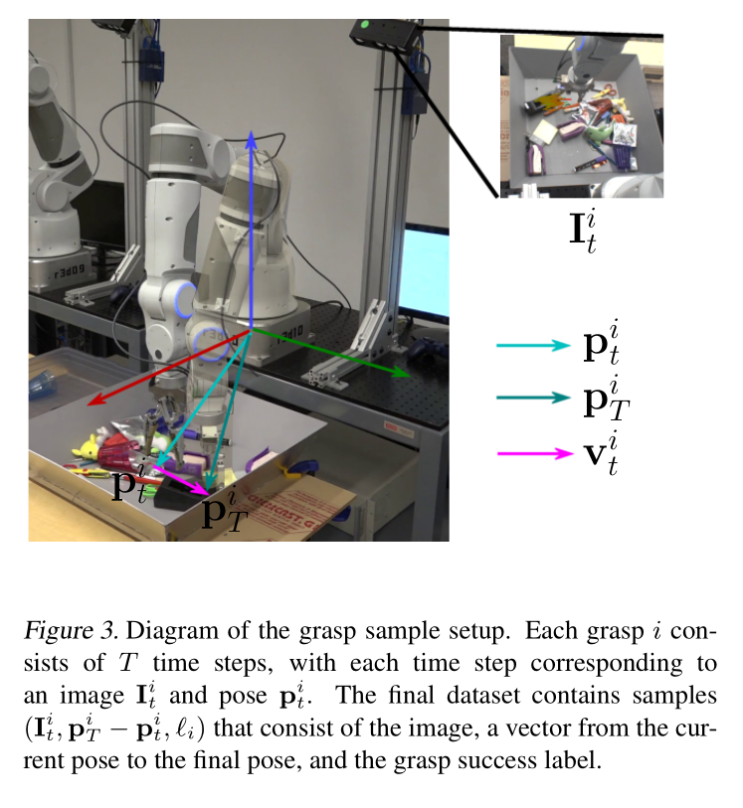
Grasp Success Prediction with Convolutional Neural Networks

Slide 9
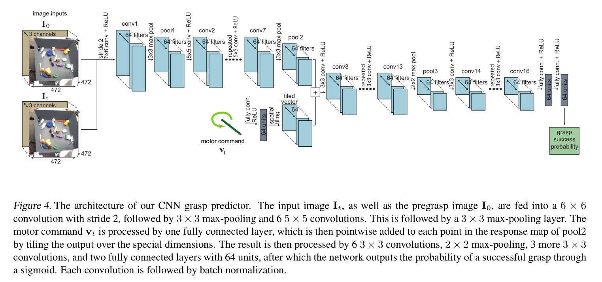
Grasp Success Prediction with Convolutional Neural Networks

Slide 10
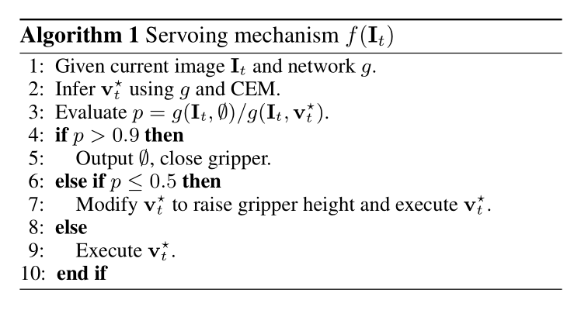
Visual
two heuristics
The rationale behind this is to stop the grasp early if closing the gripper is nearly as likely to produce a successful grasp as moving it.
The rationale behind this choice is that, if closing the gripper now is substantially worse than moving it, the gripper is most likely not positioned in a good configuration, and a large motion will be required. Therefore, raising the gripper off the table minimizes the chance of hitting other objects that are in the way.

Slide 11
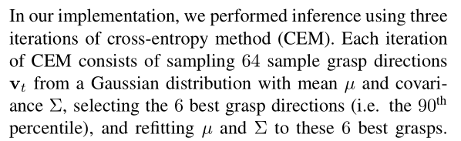
Visual

Slide 12
Data collection

Slide 13
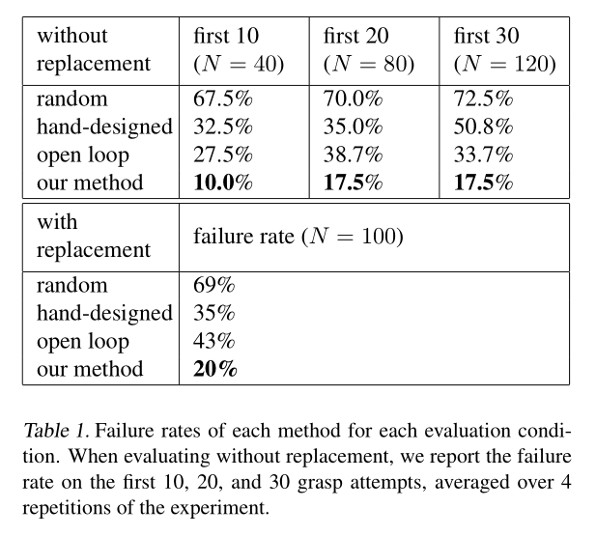
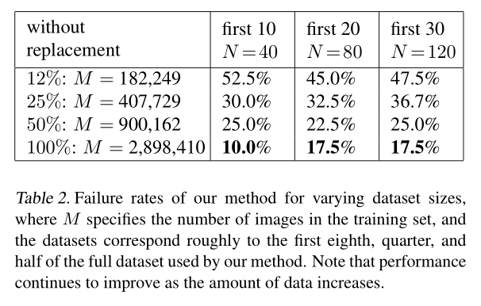
Result

Slide 14
Discussion
The main contributions of this work are a method for learning continuous visual servoing for robotic grasping from monocular cameras, a novel convolutional neural network architecture for learning to predict the outcome of a grasp attempt, and a large-scale data collection framework for robotic grasps.

Slide 15
Thank you

